Slide 1
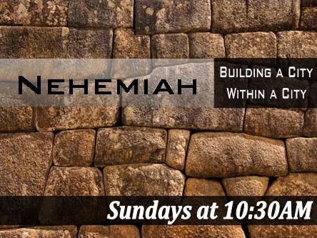
Title Slide
Wall-to-Wall People
Rick Griffith • Crossroads International Church • BibleStudyDownloads.org

Slide 2
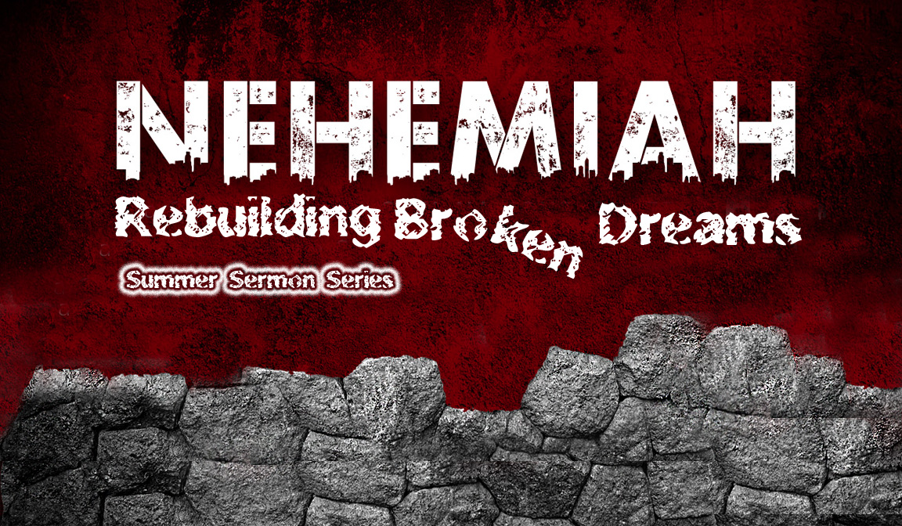
Our Present Sermon Series
July-October 2013

Slide 3
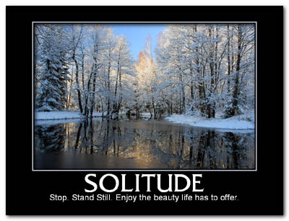
Solitude
SOLITUDE
Stop. Stand still. Enjoy the beauty life has to offer.

Slide 4
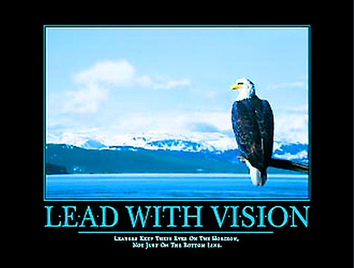
Lead with Vision

Slide 5
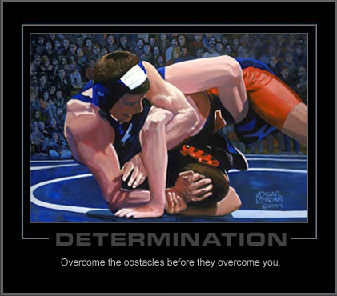
Motivational Posters
DETERMINATION
Overcome the obstacles before they overcome you.

Slide 6
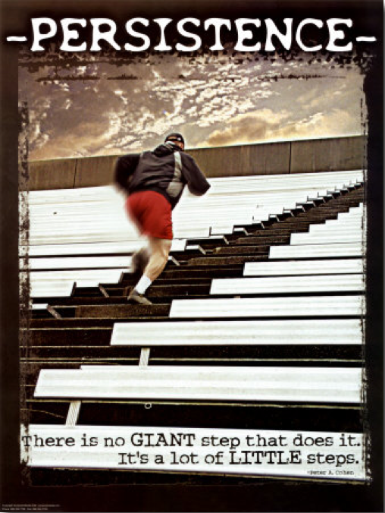
Persistent Steps

Slide 7
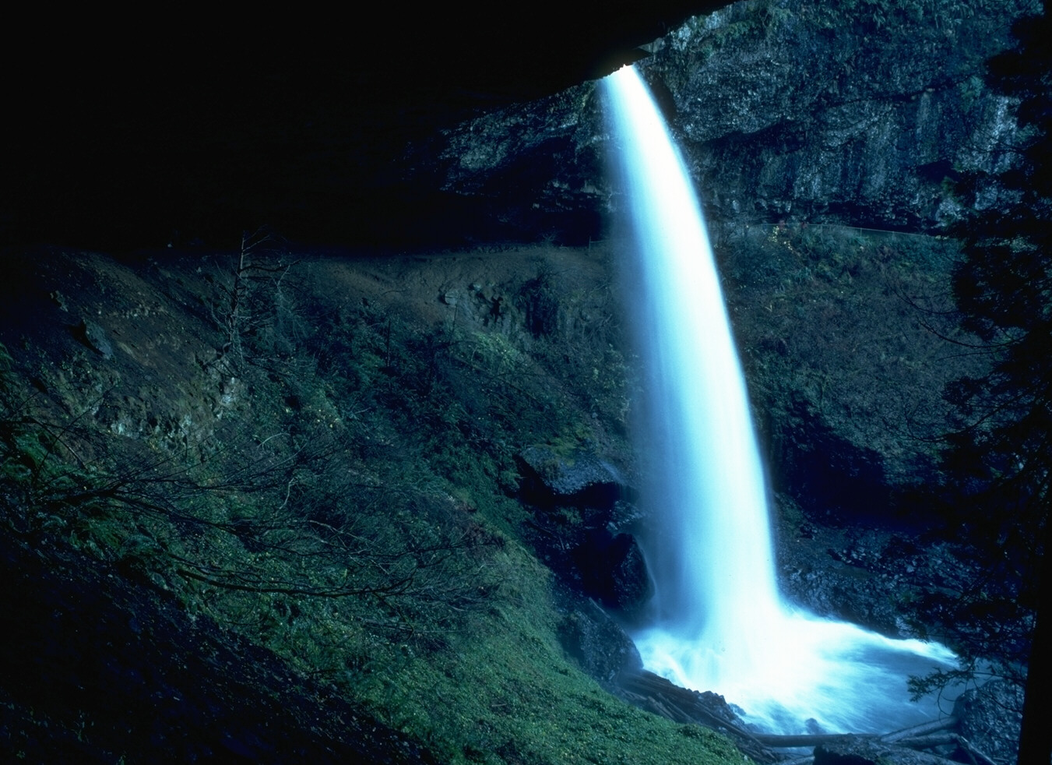
PERSISTENCE
“In the confrontation between the stream and the rock, the stream always wins –– not through strength, but through persistence.”
–– H. Jackson Brown

Slide 8
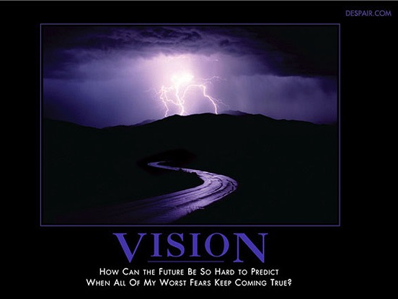
Despair.com
VISION
How can the future be so hard to predict when all of my worst fears keep coming true?

Slide 9
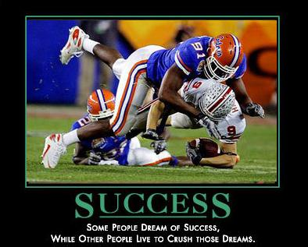
Success
SUCCESS
Some people dream of success, while other people live to crush those dreams.

Slide 10
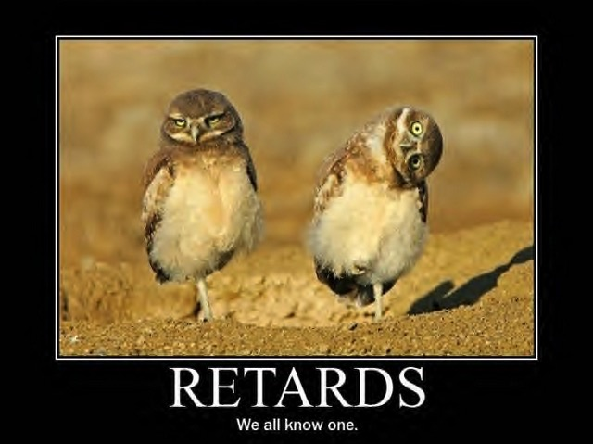
Retards
RETARDS
We all know one.

Slide 11
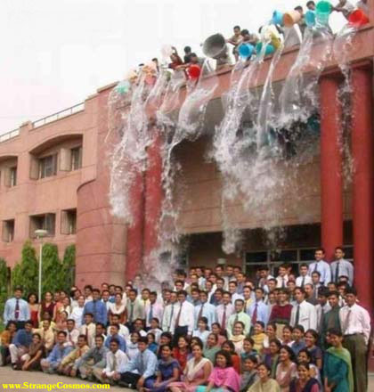
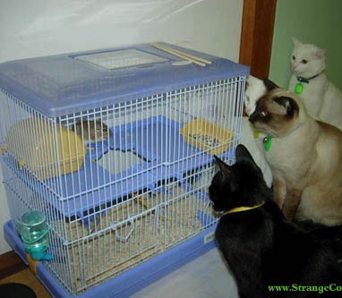
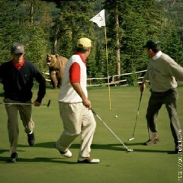
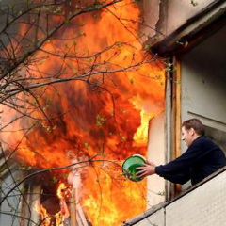
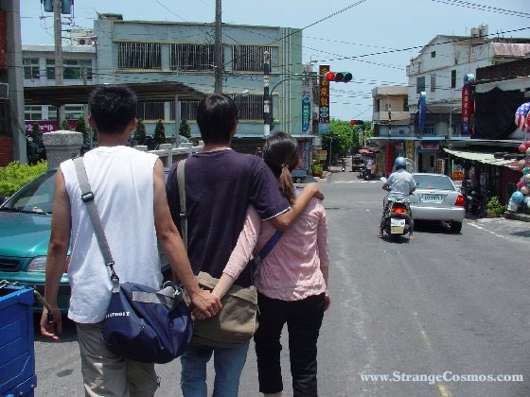
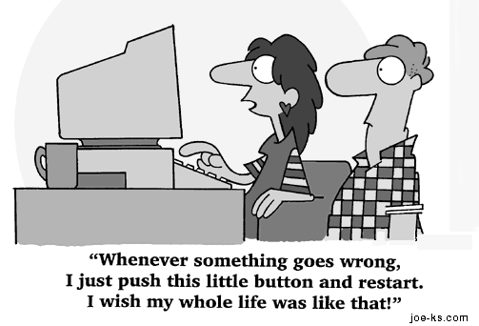
Do YOU experience opposition right now?
Notes:
11

Slide 12

Rebuilding (Neh. 1–7)
EZRA
NEHEMIAH
  Restoring 3–6
  Progress 3–7
  Returning 1–2
  Returning 7–8
  Planning 1–2
  Restoring 9–10
Rebuilding
1-6
Redirecting
7–10
Rebuilding
1–7
Zerubbabel
Ezra
Nehemiah
537
457
444

Slide 13
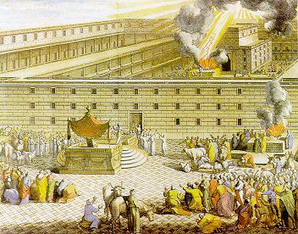
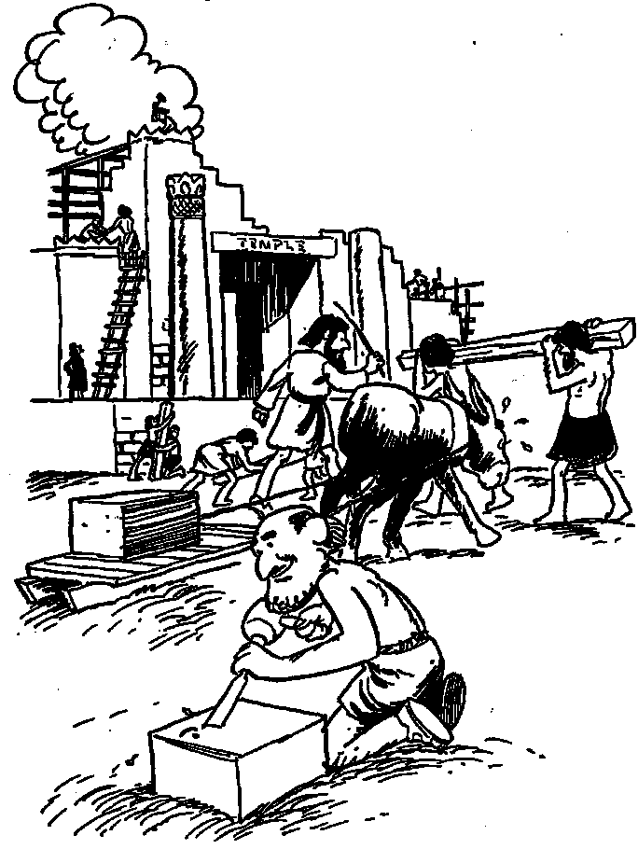
Zerubbabel
Restoring the Temple
Notes:
13

Slide 14
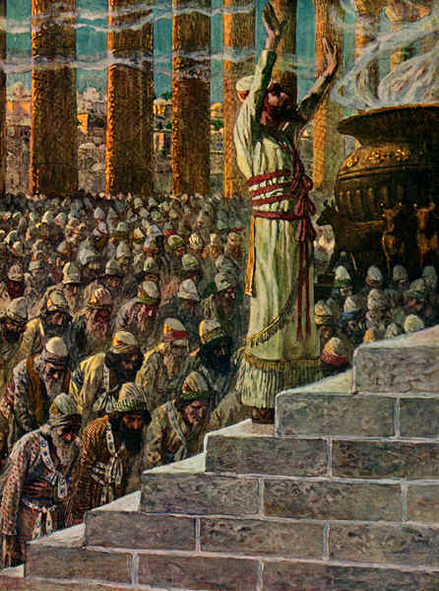
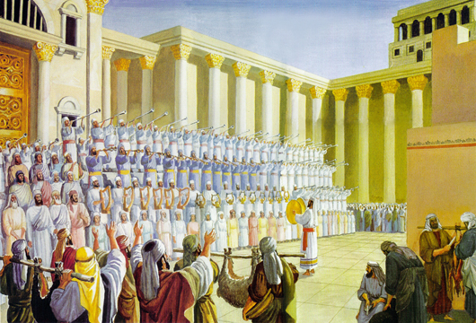
In 520 BC returning Jews celebrated the temple completion
Notes:
14

Slide 15
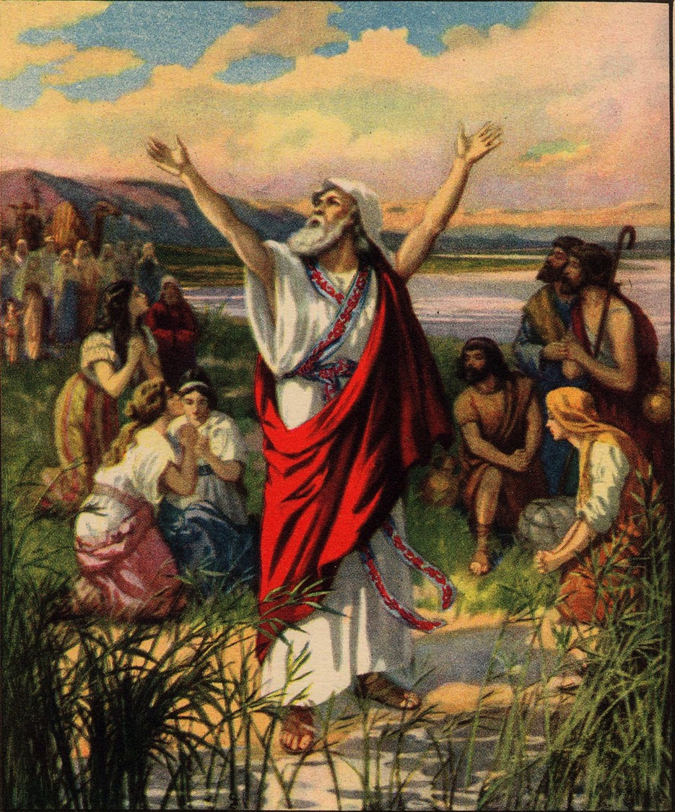
Ezra thanks God for his help

Slide 16
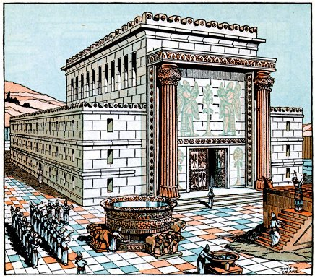
The temple was unprotected without city walls
Notes:
16

Slide 17
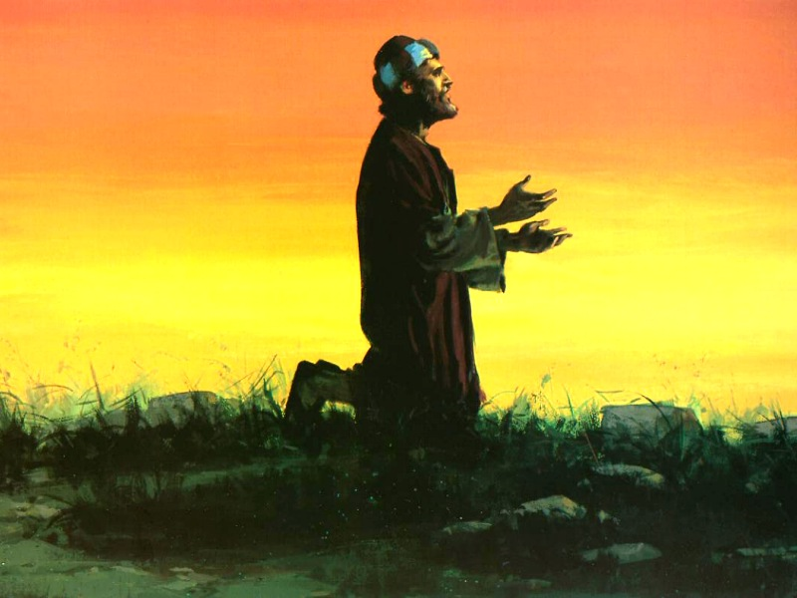
Prayer and vision

Slide 18
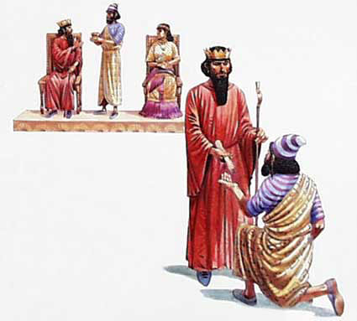
King's Help Granted

Slide 19
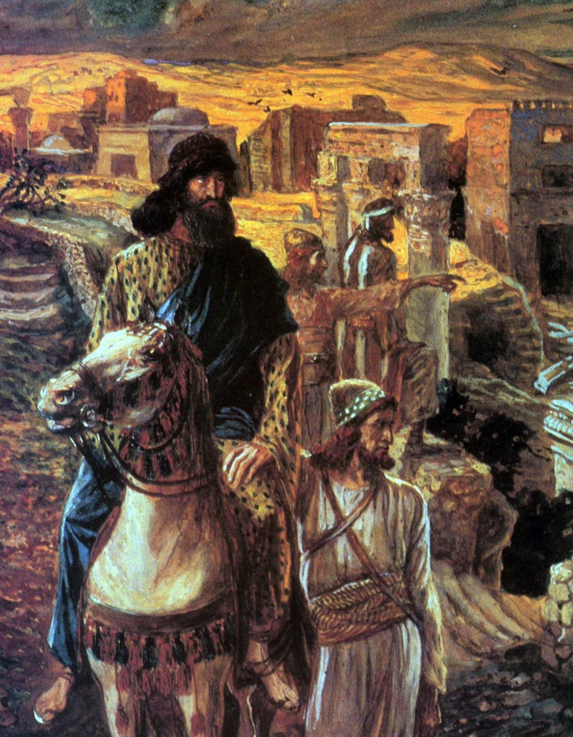
Nehemiah wisely investigated the situation before getting started
Notes:
19

Slide 20
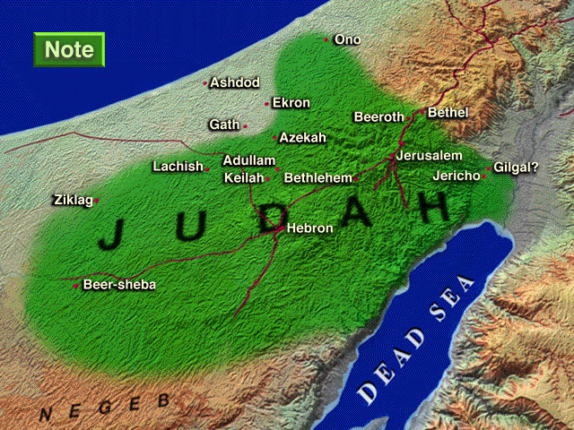
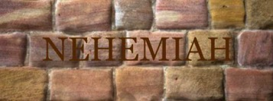
Enemies in Nehemiah's Time
Sanballat
the Samaritan
Tobiah
the Ammonite
NEHEMIAH
Geshom
the Arab
Notes:
20
^{18�} Then I told them about how the gracious hand of God had been on me, and about my conversation with the king.
They replied at once, “Yes, let's rebuild the wall!” So they began the good work.
^{19�} But when Sanballat, Tobiah, and Geshem the Arab heard of our plan, they scoffed contemptuously. “What are you doing? Are you rebelling against the king?” they asked.
^{20�} I replied, “The God of heaven will help us succeed. We, his servants, will start rebuilding this wall. But you have no share, legal right, or historic claim in Jerusalem.”
Tyndale House Publishers., Holy Bible : New Living Translation., 2nd ed. (Wheaton, Ill.: Tyndale House Publishers, 2004), Ne 2:18.
Map Has Settlements of the Persian Province of Judah According to Ezra and Nehemiah (Logos Libronix Bible Maps, Mac edition, 2008)

Slide 21

How does God help us serve Him when we’re opposed?

Slide 22
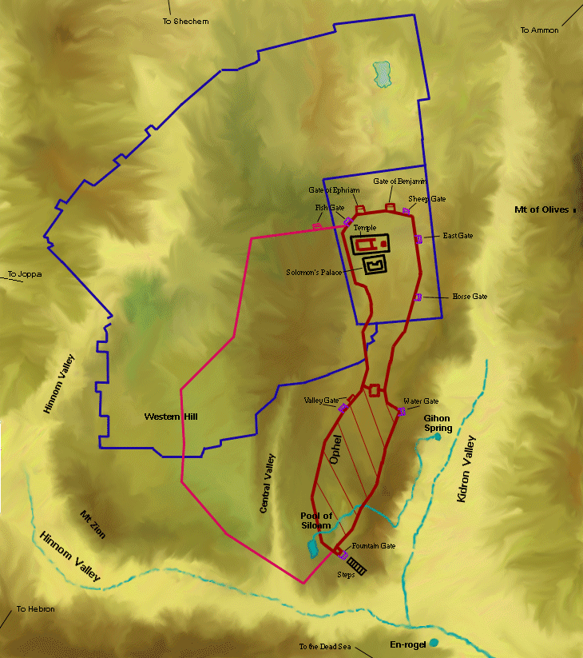
Wall-to-Wall Workers (Neh. 3:1-2)
304
Tower of Hananel
Tower of 100
Mount of Olives
¹Then Eliashib the high priest and the other priests started to rebuild at the Sheep Gate. They dedicated it and set up its doors, building the wall as far as the • Tower of the Hundred, which they dedicated, • and the Tower of Hananel. ²People from the town of Jericho worked next to them, and beyond them was Zaccur son of Imri.
Sheep Gate

Slide 23
Wall-to-Wall Workers (Neh. 3:3-5)
304
Tower of Hananel
Tower of 100
Mount of Olives
³The Fish Gate was built by the sons of Hassenaah. They laid the beams, set up its doors, and installed its bolts and bars. ⁴Meremoth son of Uriah and grandson of Hakkoz repaired the next section of wall. Beside him were Meshullam son of Berekiah and grandson of Meshezabel, and then Zadok son of Baana. ⁵Next were the people from Tekoa, though their leaders refused to work with the construction supervisors.
Sheep Gate
Fish Gate

Slide 24
Wall-to-Wall Workers (Neh. 3:6-7)
304
Tower of Hananel
Tower of 100
Mount of Olives
⁶The Old City Gate was repaired by Joiada son of Paseah and Meshullam son of Besodeiah. They laid the beams, set up its doors, and installed its bolts and bars. ⁷Next to them were • Melatiah from Gibeon, Jadon from Meronoth, people from Gibeon, and people from Mizpah, the headquarters of the governor of the province west of the Euphrates River.
Sheep Gate
Fish Gate
Jeshanah (Old Gate?)

Slide 25
Wall-to-Wall Workers (Neh. 3:8)
304
⁸Next was Uzziel son of Harhaiah, a goldsmith by trade, who also worked on the wall. Beyond him was Hananiah, a manufacturer of perfumes. They left out a section of Jerusalem as they built • the Broad Wall.
Tower of Hananel
Tower of 100
Mount of Olives
Sheep Gate
Fish Gate
Jeshanah (Old Gate?)
Broad Wall

Slide 26
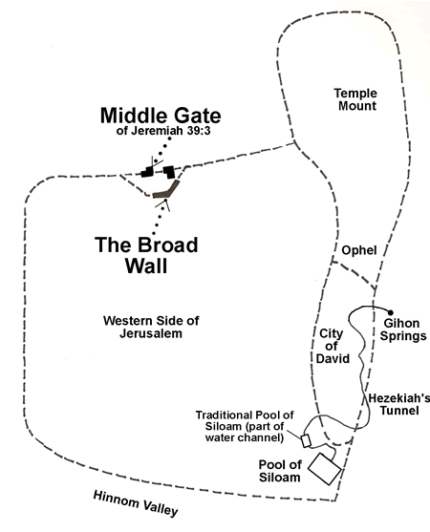
The Two Broad Walls
Temple Mount
Middle Gate
of Jeremiah 39:3
Hezekiah's was an earlier western extension before Nehemiah's broad wall
Ophel
Hezekiah's Broad Wall
Western Side of Jerusalem
Gihon Spring
City of David
Hezekiah's Tunnel
Traditional Pool of Siloam (part of water channel)
http://www.generationword.com/jerusalem101/24-broad-wall.html
Pool of Siloam
Hinnom Valley

Slide 27
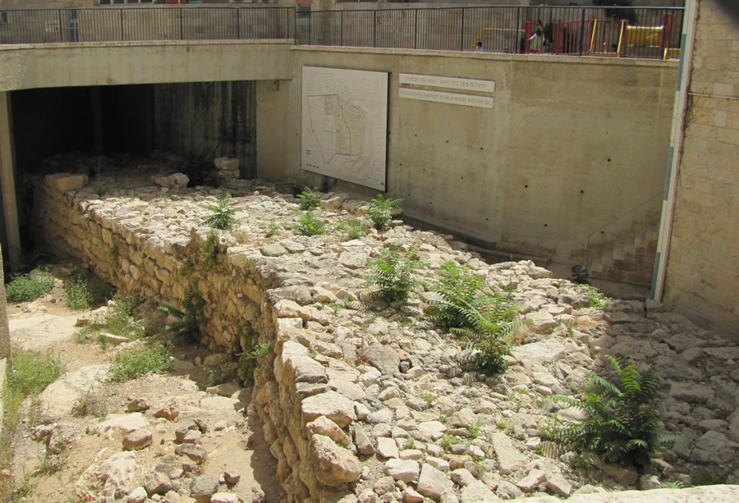
Hezekiah's Broad Wall
Notes:
"A section of the Broad Wall built by Hezekiah around 721 BC to the west of the Temple Mount and the City of David. This wall was built over the Central Valley and up onto the Western Hill to enclose homes in the part of the city that expanded when the Assyrians invaded Israel to the north. Many people from the northern kingdom of Israel fled their country and moved into Judah and Jerusalem in order to escape the Assyrian invasion. Hezekiah protected them with this wall. The remains of the wall in this photo measure 22 feet wide and 213 feet long…Another view of the same portion of the remains of the 2,700 year old Broad Wall, which today sits below street level in the Jewish Quarter. It was uncovered in 1970 during the excavations that took place in the Old City after the Six-Day War won by Israel in 1967" (http://www.generationword.com/jerusalem101/24-broad-wall.html accessed 19 Octo 2013).

Slide 28
The Two Broad Walls
Temple Mount
Middle Gate
of Jeremiah 39:3
Hezekiah's was an earlier western extension before Nehemiah's broad wall
Ophel
Nehemiah's Broad Wall
Hezekiah's Broad Wall
Western Side of Jerusalem
Gihon Spring
City of David
Hezekiah's Tunnel
Traditional Pool of Siloam (part of water channel)
http://www.generationword.com/jerusalem101/24-broad-wall.html
Pool of Siloam
Hinnom Valley

Slide 29
Wall-to-Wall Workers (Neh. 3:9-10)
304
⁹Rephaiah son of Hur, the leader of half the district of Jerusalem, was next to them on the wall and next to him was Hattush son of Hashabneiah. ¹⁰Next Jedaiah son of Harumaph repaired the wall across from his own house, and next to him was Hattush son of Hashabneiah.
Tower of Hananel
Tower of 100
Mount of Olives
Sheep Gate
Fish Gate
Jeshanah (Old Gate?)
Broad Wall

Slide 30
Wall-to-Wall Workers (Neh. 3:11-12)
304
Tower of Hananel
Tower of 100
Mount of Olives
11Then came Malkijah son of Harim and Hasshub son of Pahath-moab, who repaired another section of the wall • and the Tower of the Ovens. 12Shallum son of Hallohesh and his daughters repaired the next section. He was the leader of the other half of the district of Jerusalem.
Sheep Gate
Fish Gate
Jeshanah (Old Gate?)
Broad Wall
Tower of the Ovens?

Slide 31
Wall-to-Wall Workers (Neh. 3:13-14)
304
¹³The Valley Gate was repaired by the people from Zanoah, led by Hanun. They set up its doors and installed its bolts and bars. They also repaired the 1,500 feet of wall to the Dung Gate. • ¹⁴The Dung Gate was repaired by Malkijah son of Recab, the leader of the Bethhakkerem district. He rebuilt it, set up its doors, and installed its bolts and bars.
Tower of Hananel
Tower of 100
Mount of Olives
Sheep Gate
Fish Gate
Jeshanah (Old Gate?)
Broad Wall
Tower of the Ovens?
Valley Gate
Dung Gate

Slide 32
Wall-to-Wall Workers (Neh. 3:15)
304
¹⁵The Fountain Gate was repaired by Shallum son of Col-hozeh, the leader of the Mizpah district. He rebuilt it, roofed it, set up its doors, and installed its bolts and bars. • Then he repaired the wall of the pool of Siloam near the king's garden, and he rebuilt the wall as far as the stairs that descend from the City of David.
Tower of Hananel
Tower of 100
Mount of Olives
Sheep Gate
Fish Gate
Jeshanah (Old Gate?)
Broad Wall
Tower of the Ovens?
Valley Gate
Dung Gate
Pool of Shelah (Siloam)
Fountain Gate

Slide 33
Wall-to-Wall Workers (Neh. 3:16-17)
304
¹⁶Next to him was Nehemiah son of Azbuk, the leader of half the district of Beth-zur. • He rebuilt the wall from a place across from the tombs of David's family as far as the water reservoir and the House of the Warriors. ¹⁷Next to him, repairs were made by a group of Levites working under the supervision of Rehum son of Bani. Then came Hashabiah, the leader of half the district of Keilah, who supervised the building of the wall on behalf of his own district.
Tower of Hananel
Tower of 100
Mount of Olives
Sheep Gate
Fish Gate
Jeshanah (Old Gate?)
Broad Wall
Tower of the Ovens?
Valley Gate
Dung Gate
Pool of Shelah (Siloam)
Fountain Gate

Slide 34
Wall-to-Wall Workers (Neh. 3:18-19)
304
18 Next down the line were his countrymen led by Binnui son of Henadad, the leader of the other half of the district of Keilah. 19Next to them, Ezer son of Jeshua, the leader of Mizpah, • repaired another section of wall across from the ascent to the armory near the angle in the wall.
Tower of Hananel
Tower of 100
Mount of Olives
Sheep Gate
Fish Gate
Jeshanah (Old Gate?)
Broad Wall
Tower of the Ovens?
Valley Gate
Dung Gate
The Angle
Pool of Shelah (Siloam)
Fountain Gate

Slide 35
Wall-to-Wall Workers (Neh. 3:20-22)
304
²⁰Next to him was Baruch son of Zabbai, who zealously repaired an additional section from • the angle to the door of the house of Eliashib the high priest. ²¹Meremoth son of Uriah and grandson of Hakkoz rebuilt another section of the wall extending from the door of Eliashib's house to the end of the house. ²²The next repairs were made by the priests from the surrounding region.
Tower of Hananel
Tower of 100
Mount of Olives
Sheep Gate
Fish Gate
Jeshanah (Old Gate?)
Broad Wall
Tower of the Ovens?
Valley Gate
Dung Gate
The Angle
Pool of Shelah (Siloam)
Fountain Gate

Slide 36
Wall-to-Wall Workers (Neh. 3:23-24)
304
²³After them, Benjamin and Hasshub repaired the section across from their house, and Azariah son of Maaseiah and grandson of Ananiah repaired the section across from his house. ²⁴Next was Binnui son of Henadad, who rebuilt another section of the wall from Azariah's house to the angle and the corner.
Tower of Hananel
Tower of 100
Mount of Olives
Sheep Gate
Fish Gate
Jeshanah (Old Gate?)
Broad Wall
Tower of the Ovens?
Valley Gate
Dung Gate
The Angle
Pool of Shelah (Siloam)
Fountain Gate

Slide 37
Wall-to-Wall Workers (Neh. 3:25-26)
304
²⁵Palal son of Uzai carried on the work from a point opposite the angle and the tower that projects up from the king's upper house beside the court of the guard. Next to him were Pedaiah son of Parosh, ²⁶with the Temple servants living on the hill of Ophel, who repaired the wall as far as a point across from • the Water Gate to the east • and the projecting tower.
Tower of Hananel
Tower of 100
Mount of Olives
Sheep Gate
Fish Gate
Jeshanah (Old Gate?)
Broad Wall
Tower of the Ovens?
Great Projecting Tower
Valley Gate
Water Gate
Dung Gate
The Angle
Pool of Shelah (Siloam)
Fountain Gate

Slide 38
Wall-to-Wall Workers (Neh. 3:27-28)
304
²⁷Then came the people of Tekoa, who repaired another section across from the great projecting tower • and over to the wall of Ophel. • ²⁸Above the Horse Gate, the priests repaired the wall. Each one repaired the section immediately across from his own house.
Tower of Hananel
Tower of 100
Mount of Olives
Sheep Gate
Fish Gate
Jeshanah (Old Gate?)
Broad Wall
Horse Gate
Tower of the Ovens?
Wall of Ophel
Great Projecting Tower
Valley Gate
Water Gate
Dung Gate
The Angle
Pool of Shelah (Siloam)
Fountain Gate

Slide 39
Wall-to-Wall Workers (Neh. 3:29-30)
304
²⁹Next Zadok son of Immer also rebuilt the wall across from his own house, and beyond him was Shemaiah son of Shecaniah, • the gatekeeper of the East Gate. • ³⁰Next Hananiah son of Shelemiah and Hanun, the sixth son of Zalaph, repaired another section, while Meshullam son of Berekiah rebuilt the wall across from where he lived.
Tower of Hananel
Tower of 100
Mount of Olives
Sheep Gate
Fish Gate
Jeshanah (Old Gate?)
East Gate
Broad Wall
Horse Gate
Tower of the Ovens?
Wall of Ophel
Great Projecting Tower
Valley Gate
Water Gate
Dung Gate
The Angle
Pool of Shelah (Siloam)
Fountain Gate

Slide 40
Wall-to-Wall Workers (Neh. 3:31-32)
304
³¹Malkijah, one of the goldsmiths, repaired the wall as far as the housing for the Temple servants and merchants, across from • the Inspection Gate. Then he continued as far as the upper room at the corner. ³²The other goldsmiths and merchants repaired the wall from that corner to • the Sheep Gate.
Tower of Hananel
Tower of 100
Mount of Olives
Sheep Gate
Fish Gate
Inspection Gate
Jeshanah (Old Gate?)
East Gate
Broad Wall
Horse Gate
Tower of the Ovens?
Wall of Ophel
Great Projecting Tower
Valley Gate
Water Gate
Dung Gate
The Angle
Pool of Shelah (Siloam)
Fountain Gate

Slide 41
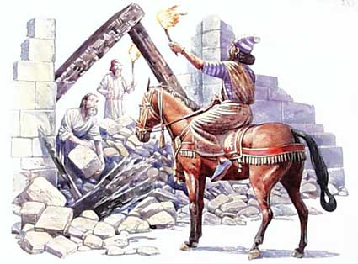
How does God help us serve Him when we’re opposed?

Slide 42
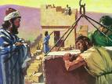
I. God helps us to be sensible to overcome opposition.
A. Nehemiah 3 makes sense…
• Geographic: They worked at the right spots on the wall

Slide 43
Wall-to-Wall Workers (Neh. 3:1-2)
304
Tower of Hananel
Tower of 100
Mount of Olives
¹Then Eliashib the high priest and the other priests started to rebuild at the Sheep Gate. They dedicated it and set up its doors, building the wall as far as the Tower of the Hundred, which they dedicated, and the Tower of Hananel. ²People from the town of Jericho worked next to them, and beyond them was Zaccur son of Imri.
Sheep Gate
Notes:
43

Slide 44
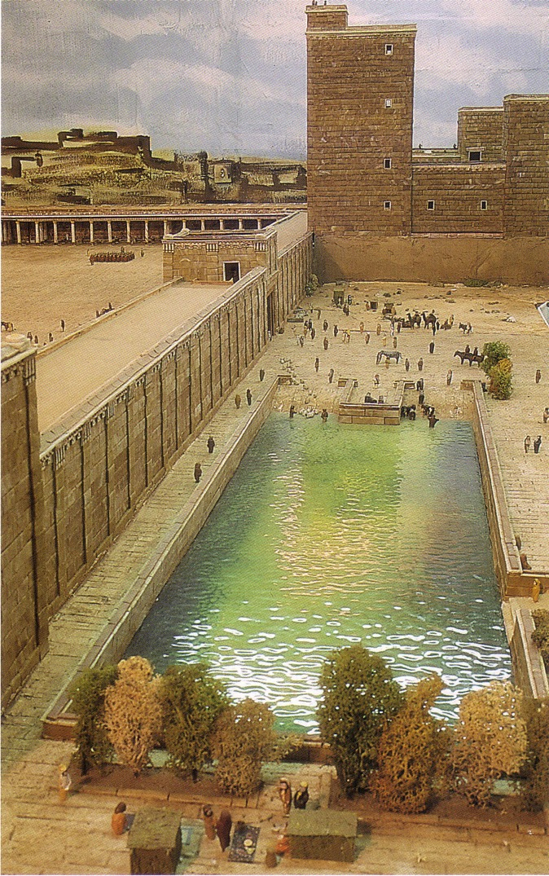
The Sheep Gate
North of the temple, it connected the Sheep Pool to the temple complex.
(looking west)
Notes:
44

Slide 45
Wall-to-Wall Workers (Neh. 3:20-22)
304
²⁰Next to him was Baruch son of Zabbai, who zealously repaired an additional section from the angle to the door of the house of Eliashib the high priest. ²¹Meremoth son of Uriah and grandson of Hakkoz rebuilt another section of the wall extending from the door of Eliashib's house to the end of the house. ²²The next repairs were made by the priests from the surrounding region.
Tower of Hananel
Tower of 100
Mount of Olives
Sheep Gate
Fish Gate
Jeshanah (Old Gate?)
Broad Wall
Tower of the Ovens?
Valley Gate
Dung Gate
The Angle
Pool of Shelah (Siloam)
Fountain Gate
Notes:
45

Slide 46
Wall-to-Wall Workers (Neh. 3:23-24)
304
²³After them, Benjamin and Hasshub repaired the section across from their house, and Azariah son of Maaseiah and grandson of Ananiah repaired the section across from his house. ²⁴Next was Binnui son of Henadad, who rebuilt another section of the wall from Azariah's house to the angle and the corner.
Tower of Hananel
Tower of 100
Mount of Olives
Sheep Gate
Fish Gate
Jeshanah (Old Gate?)
Broad Wall
Tower of the Ovens?
Valley Gate
Dung Gate
The Angle
Pool of Shelah (Siloam)
Fountain Gate
Notes:
46

Slide 47
Opposing Quotes on Work
Wiersbe notes, “When it comes to the work of the Lord, there is no place for spectators or self-appointed advisors and critics; but there is always room for workers.”
British humorist Jerome K. Jerome said,
“I like work, it fascinates me. I can sit and look at it for hours.”
Notes:
47

Slide 48
I. God helps us to be sensible to overcome opposition
A. Nehemiah 3 makes sense…
• Geographic: They worked at the right spots on the wall
• Communal

Slide 49
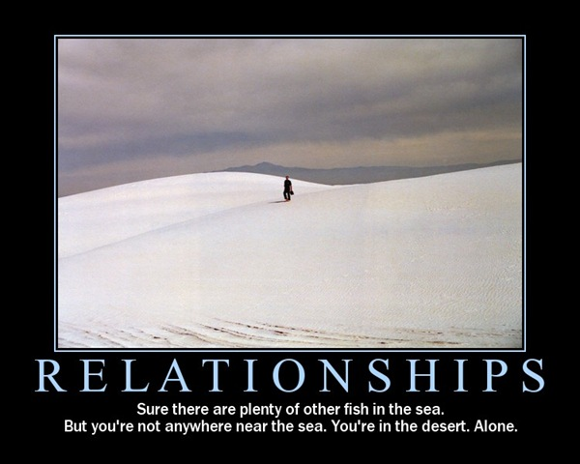
Relational Despair
Sure there are plenty of other fish in the sea. But you're not anywhere near the sea. You're in the desert. Alone.

Slide 50
I. God helps us to be sensible to overcome opposition
A. Nehemiah 3 makes sense…
• Geographic: They worked at the right spots on the wall
• Communal
• Inconvenient
• Complete

Slide 51
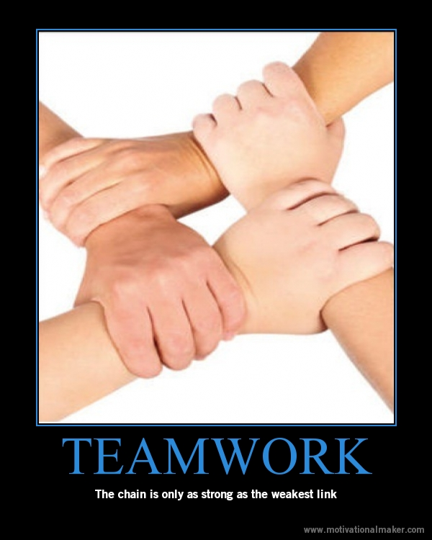
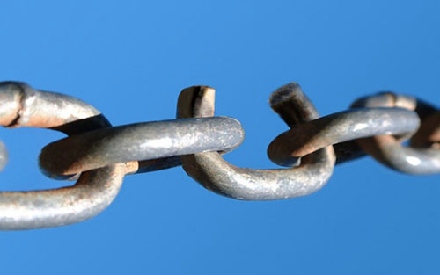
Relational Despair
A chain is as strong as its weakest link.

Slide 52
I. God helps us to be sensible to overcome opposition
A. Nehemiah 3 makes sense…
• Geographic: They worked at the right spots on the wall
• Communal
• Inconvenient
• Complete
• Reasonable

Slide 53
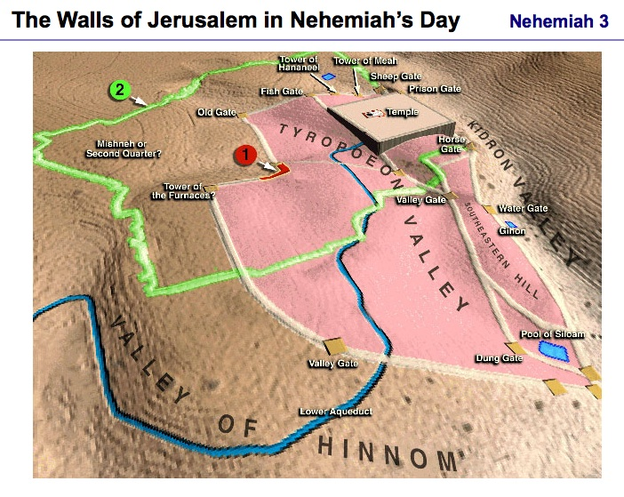
The Walls of Jerusalem in Nehemiah's Day

Slide 54
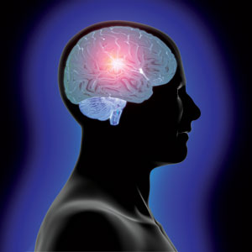
B. God calls us to serve him in sensible ways to protect His church

Slide 55
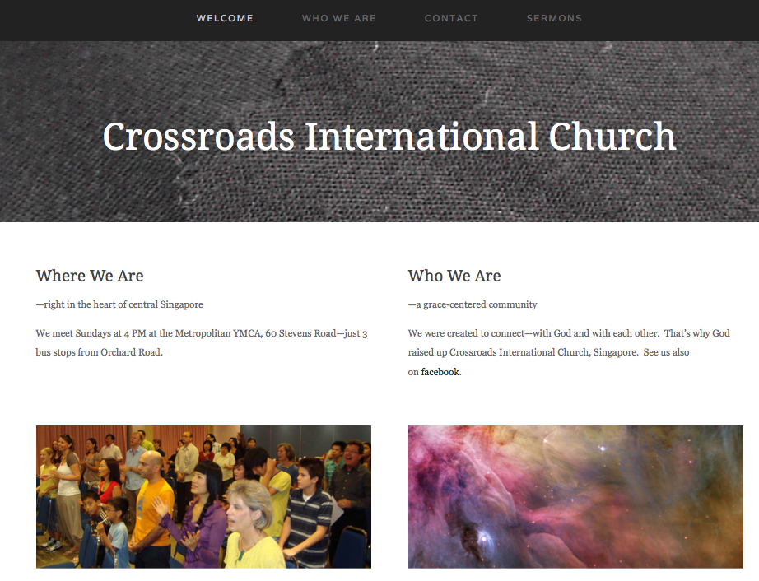
Check Out Our Website…

Slide 56
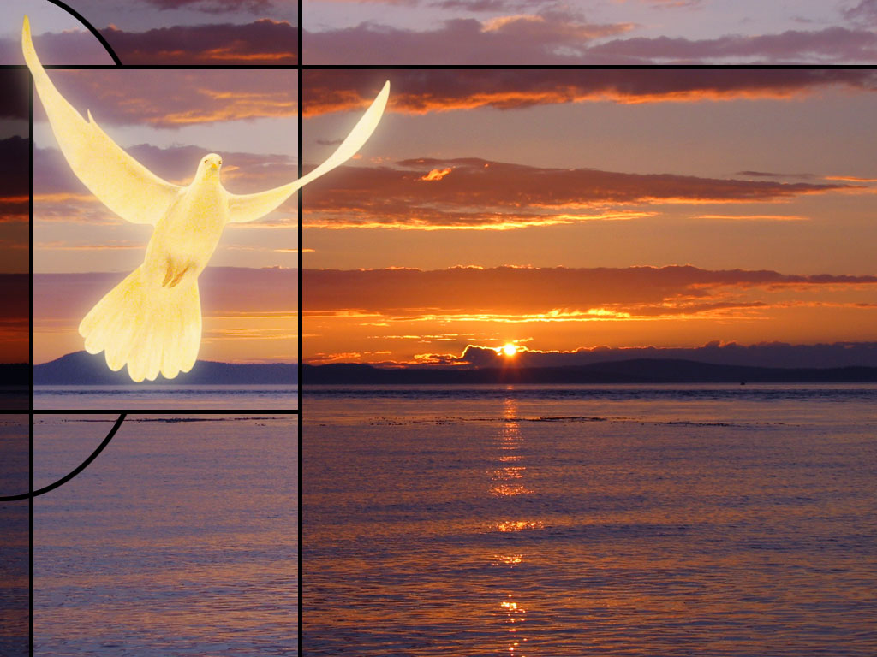
Our Mission
The mission of Crossroads is to reach the nations by reaching internationals residing in Singapore

Slide 57
Our Vision
The vision of Crossroads is to lead internationals into a vital relationship with Jesus Christ as disciples who can transform their unique spheres of influence
(2 Tim. 2:2). In particular, Crossroads focuses primarily, but not exclusively, on reaching the English-speaking community.
Notes:
57

Slide 58
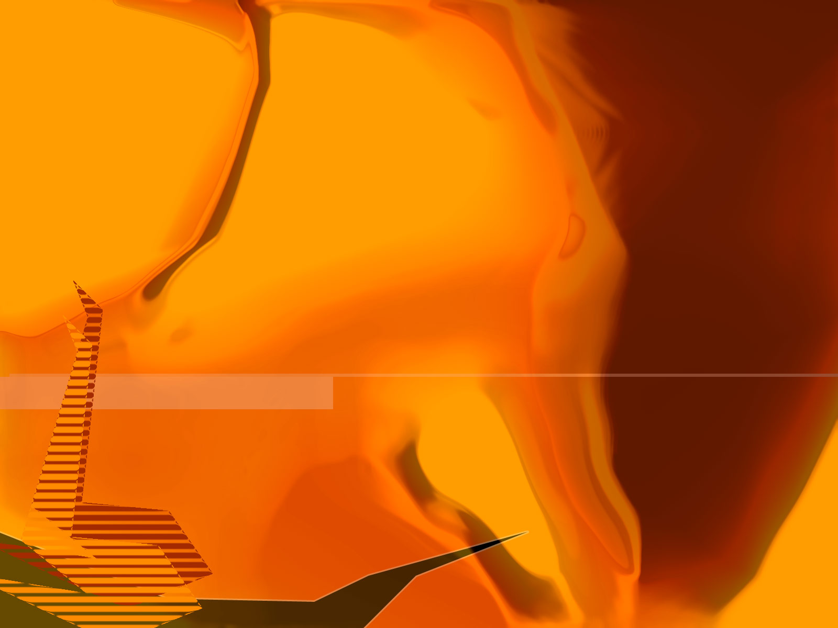

Spiritual Gifts
You have at least one!

Slide 59

Categories of Gifts
(1 Peter 4:11)
Get
words
from
God
Get
strength
from
God
Speaking | Serving
Teaching | Administering
Evangelism | Faith
Pastor-Teacher | Giving
Encouraging | Service
 | Mercy
Notes:
59

Slide 60
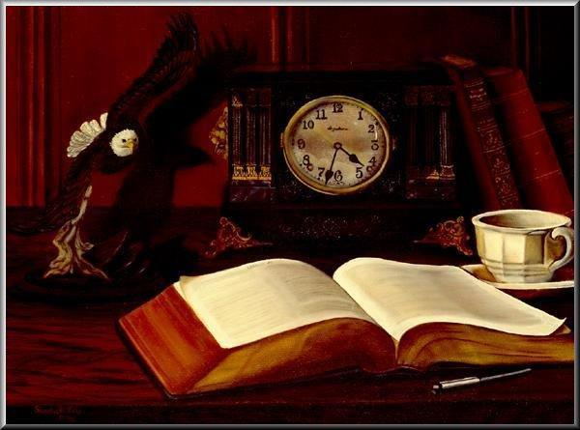
Why Study & Know Our Gifts?
1) MINISTRY TO THE CHURCH BODY - Ministering in the area of our gifts results in:
a) edification of the body— unity and interdependency (1 Cor. 14:12)
b) mobilizing the church for mission to a lost world.
c) encouraging other believers to discern and develop their gifts.

Slide 61
Why Study & Know Our Gifts?
2) PERSONAL FULFILLMENT - Exercising our gifts results in:
a) ministering in areas of strength, reducing frustration and wasted time.
b) assisting us in establishing priorities for study, growth, and ministry (Eph. 4:13).
c) a sense of usefulness and belonging in the body of Christ (1 Cor. 12:14-17).

Slide 62
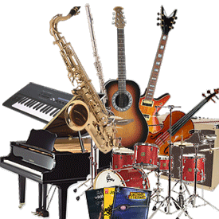
Play your own instrument

Slide 63
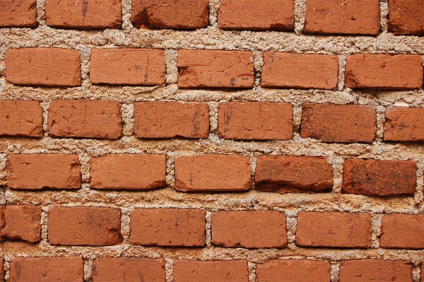

Our Crossroads Wall in August 2013
MEN
MISSIONS
EVANGELISM
• Leland
• ?????
• Albina • Singpu • Désirée
PREACHING
HOME GROUPS
• Rick
• Lewis
• Singpu (HG)
• Lewis (HG)
FINANCES
MUSIC
• Valentin
• Rick
• Athan
• David
• Susan
• Jieun
• Miriam
• Athan
• Singpu
• Shannah
• Tessa
• Gilbert
• Cynthia
WOMEN
• Susan
• Désirée
• Linda Fones
WEBSITE & AV
• Andrew
• Drew
YOUTH
NURSERY
LOGISTICS
• ????
• Athan
• Chanchan
KIDS
• Singpu
• David
• Athan
• Kim
• Kim
• Chanchan
Notes:
Building the wall together are 19 of us in leadership. Not bad considering that our church has 32 adults! Yet I'm an idealist so I'd like to see 100% involvement though!
2013: 19 of 32
2009: 28 of 46

Slide 64
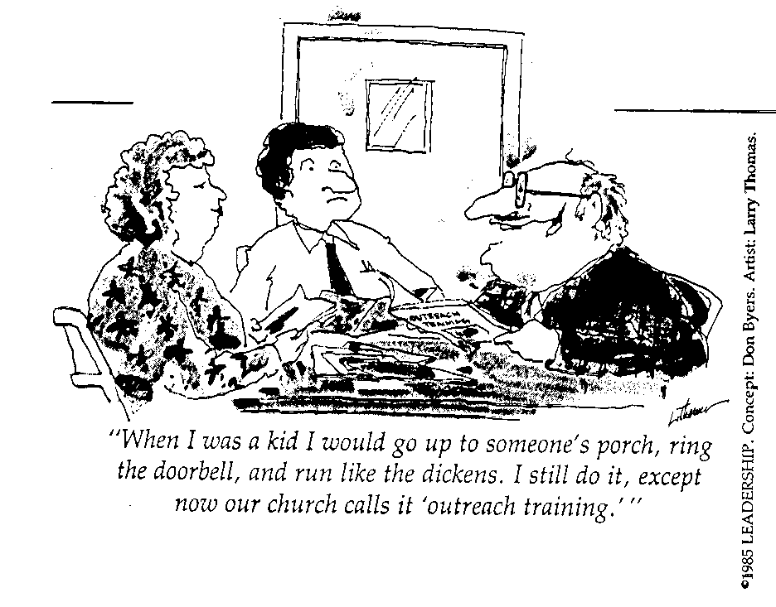
Many Fear Evangelism!
"When I was a kid I would go up to someone's porch, ring the doorbell, and run like the dickens. I still do it, except now our church calls it 'outreach training.'"

Slide 65
I. God helps us to be sensible to overcome opposition.

Slide 66
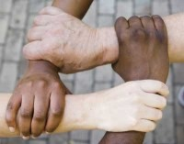
II. God helps us to be united to overcome opposition.

Slide 67
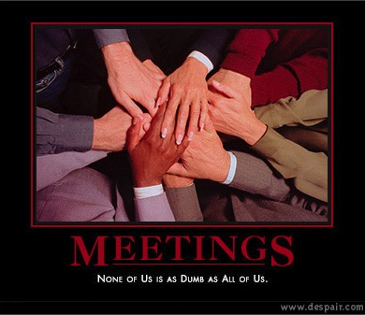
Meetings
MEETINGS
None of us is as dumb as all of us.

Slide 68
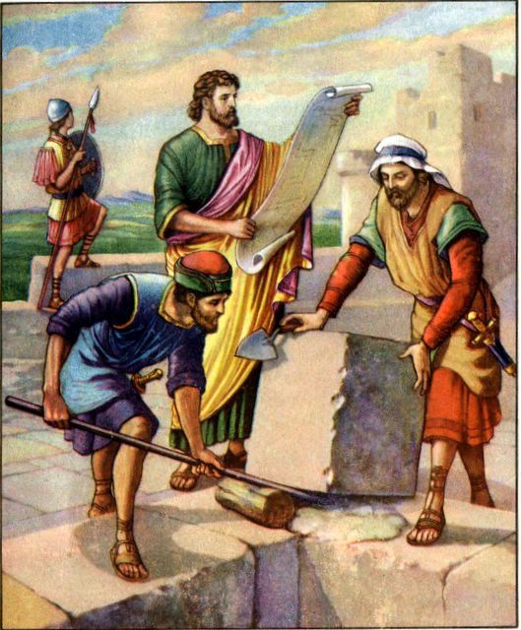
A. God united all kinds of Jews to work as common laborers

Slide 69
A. God united all kinds of Jews to work as common laborers
    Priests (1, 22, 28)
    Goldsmiths (8a, 31, 32)
    Perfumer (8b)
    Political leaders (9, 15, 16, 17, 18, 19)
    Women & men (12)
    Levites (17)
    Merchants (32)
    Even people from outside the city (2, 5, 7)

Slide 70
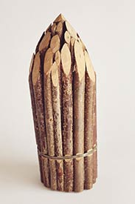
Bound sticks
Notes:
A young boy wanted to show his strength in front of the class by breaking a bunch of 20 small, thin sticks tied together. He tried hard to break these sticks tied together, but even after several attempts he failed. He gave up. Then the teacher called him and told him to untie the bunch of sticks and break them one by one. The boy found it very easy to break them. It wasn’t that difficult after all. Once the bunch of sticks was untied the sticks lost their strength. “United we stand, divided we fall.”

Slide 71
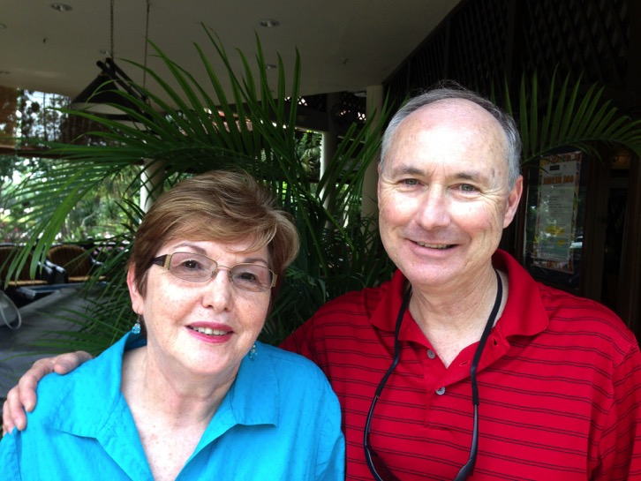




B. God unites all types of people as they serve Him today.
Crossroads International Church
Notes:
Our church has 10 nationalities and many professions represented. That was the original vision that kick-started this church into being.
How are you performing your role in unity in your given area?
The people of Jerusalem each built and repaired their portion. They did it seeing the bigger picture of the whole wall––how their portion helped the entire nation in unity.
How about us? Are we seeing the bigger picture of God’s church growing? Are we playing our part in unity?

Slide 72

He qualifies you!
God often calls us to do something for which we do not feel qualified
Notes:
But please note: God often calls us to do something for which we do not feel qualified.
That’s how we have priests, goldsmiths, perfumers, women and merchants as construction workers!
• Several of you feel inadequate to take on leading our missions or nursery ministry. I can understand that, as I also feel inadequate. But I wonder if God is working in you even today to tell you that you don’t have to be a professional to lead effectively.

Slide 73

The Main Idea of Nehemiah 3
God fights opposition through a sensible plan that includes us all.
Notes:
This passage helps to show how God gives a sensible and united plan to accomplish His will through us. God worked his will through many people and he still does today. He is a God of order. He works in the same way today to see our church grow for His glory.

Slide 74

“Some people just will not work (Neh. 3:5).
Tekoa was a town about eleven miles from Jerusalem, and some of their people traveled to Jerusalem to assist in the work. What a contrast between these people and their nobles! The Tekoites built in two places on the wall (vv. 5 and 27), while their nobles refused to bend the neck and work in even one place. Were these 'aristocrats' so important in their own eyes that they could not perform manual labor? Yet Paul was a tentmaker (Acts 18:3), and Jesus was a carpenter (Mark 6:3).”
Warren W. Wiersbe, Be Determined
(Wheaton, IL: Victor, 1996), Neh 4:1.
Notes:
What sensible part of his overall plan is His will for you? [Read quote.]
I dare say that some of the worst pew-sitters are missionaries. When I served in the Philippines in 1981, I’d talk to Filipinos at church and mention some missionaries who attended but they’d say, “Who’s that?!”

Slide 75

D.L. Moody
(died 1899)
“A great many people have got a false idea about the church. They have got an idea that the church is a place to rest in... to get into a nicely cushioned pew, and contribute to the charities, listen to the minister, and do their share to keep the church out of bankruptcy, is all they want. The idea of work for them —actual work in the church—
never enters their minds.”

Slide 76
Our Crossroads Wall in June 2009
MEN
MISSIONS
EVANGELISM
• ?
• ?
• Albina • Jasmine
PREACHING
TEACHING ADULTS
• Rick
• Lewis
• Enriko
• Brad
• Tom
• Joe
• Rick (CSB)
• Lewis (HG)
MUSIC
FINANCES
• Tom
• Wayne
• Miriam
• Jason
• Lisa
• Susan
• Enriko
• Gilbert
• Rick
• Lewis
• Evan
• Roy
WEBSITE & AV
WOMEN
• John
• Leo
• Diana
• Brad
• Susan
• Amy
• Marie
YOUTH
KIDS
LOGISTICS
• Enriko
• Brad
• Jason
• Grace
• Juliana
• Oat
• Wayne
• David
• Rick
• Joe
• Becky
• Susan
• Evan
• Mitchie
• Jasmine
• Betz
Notes:
Friends, but in Feb 2009 this is where we stood in just four months when the church lost 1/3 of its people moving out of Singapore. God raised up a new team though!

Slide 77


YOU are needed NOW!
Evangelism
Missions Coordinator
Nursery Coordinator
Downstairs Greeter
Greeters
Ushers
Youth Sponsor
AV Assistant
Drummer
Set-up & Take Down
griffith@sbc.edu.sg

Slide 78


The 13
Notes:
One little known fact is that when the founding fathers of the USA got together to form the union, they were anything but united. We see the flag with 13 stars and 13 stripes, but this didn’t come around for some time. Each state only had its own flag.

Slide 79


Benjamin Franklin
“We must all hang together, gentlemen...
or assuredly we shall all hang separately.”
––Benjamin Franklin
Notes:
Many were Christians, but of differing denominational stripes. Some hated slavery, while others owned slaves. When declaring independence, what held them together was a common hatred of England. But hatred is not a strong glue! The first dozen years after independence, they couldn’t even agree on a common currency. Yet at a deciding moment, when all seemed lost, the great statesman Benjamin Franklin stood up and addressed the group.
SLIDE ADVANCE: He declared, “We must all hang together, gentlemen... or assuredly we shall all hang separately.”

Slide 81


OT Preaching link at BibleStudyDownloads.org
Get this presentation for free!
Notes:
OT Survey (os)

